Slide 1
Introduction to Computer Networks CS156
Lecture 5-6 (Theory)
TCP/IP Model
Dr. Htet Ne Oo
Department of Computer Science and Engineering,
Chitkara University, Punjab

Slide 2
TCP/IP PROTOCOL SUITE
The layers in the TCP/IP protocol suite do not exactly match those in the OSI model.
The original TCP/IP protocol suite was defined as having four layers: host-to-network, internet, transport, and application.
However, when TCP/IP is compared to OSI, we can say that the TCP/IP protocol suite is made of five layers: physical, data link, network, transport, and application.

Slide 3
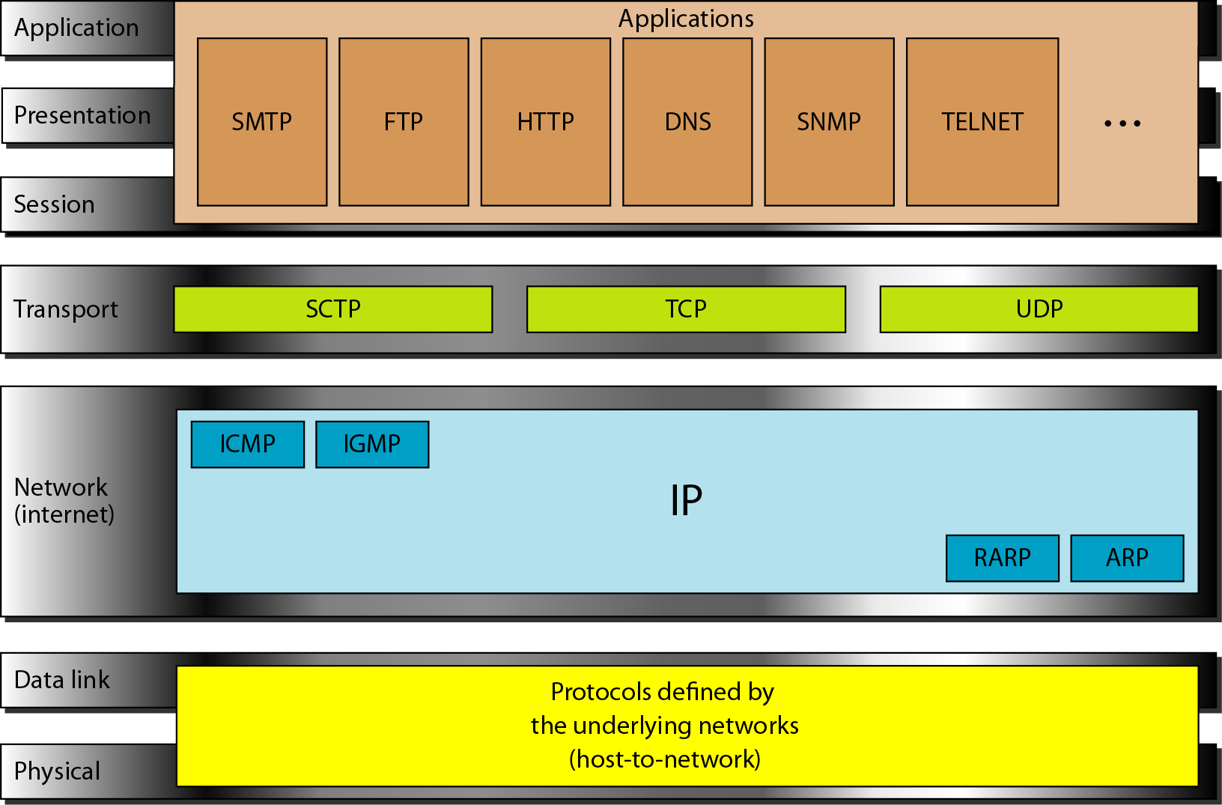
TCP/IP model

Slide 4
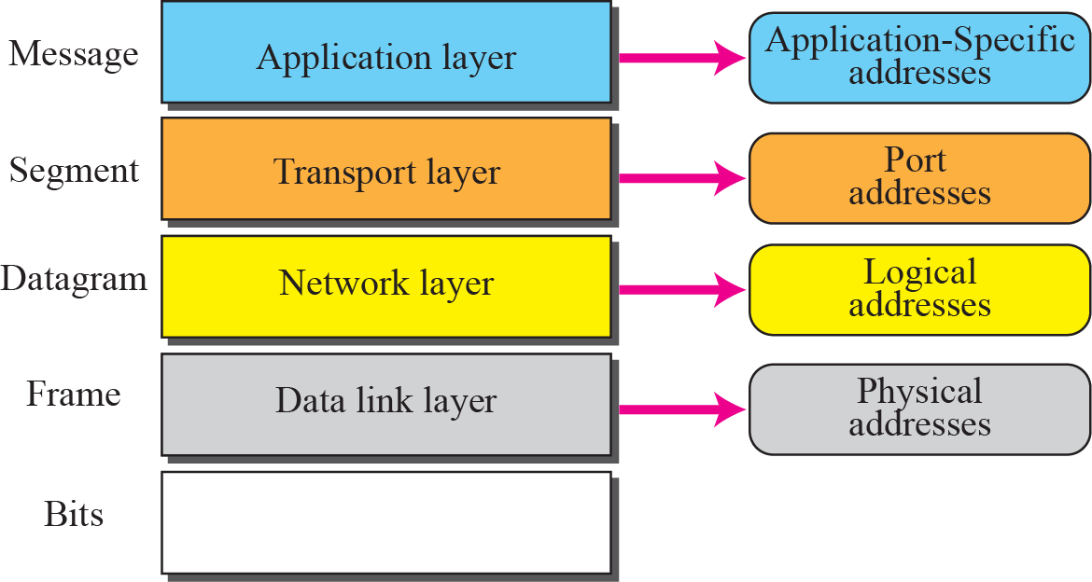
TCP/IP model
Addresses in the TCP/IP protocol suite

Slide 5
COMPARISON OF OSI AND TCP/IP MODEL
One of the major difference is that OSI is a conceptual model which is not practically used for communication, whereas, TCP/IP is used for establishing a connection and communicating through the network.
The OSI model mainly emphasis on the services, interfaces and protocols; make a clear distinction between these concepts.
Conversely, the TCP model is not able to distinctly describe these concepts.

Slide 6
COMPARISON OF OSI AND TCP/IP MODEL
Furthermore, the TCP/IP enables only connectionless communication mode in the network layer but both modes (Connectionless and connection-oriented) in the transport layer.
When it comes to the OSI model, it supports connectionless and connection-oriented communication over the network layer but in the transport layer, connection-oriented communication is merely allowed.

Slide 7
COMPARISON OF OSI AND TCP/IP MODEL
OSI (Open System Interconnection) model was introduced by ISO (International Standard Organization).
Currently OSI (Open System Interconnection) model is just a reference model.
Means that, there are no real working implementations of OSI Model on any of latest network infrastructure devices or Operating Systems.
OSI (Open System Interconnection) model is used these days only as a reference model for teaching computer networking concepts and for understanding how computer networks operate.

Slide 8
COMPARISON OF OSI AND TCP/IP MODEL
The roots of TCP/IP (Transmission Control Protocol Internet Protocol) are with US Department of Defense (DoD).
Original TCP/IP (Transmission Control Protocol/Internet Protocol) model had only four layers, and later an updated model evolved with five layers.
TCP/IP protocol suite and thus TCP/IP model got wider acceptance than OSI model, because world’s largest network internet started operating using TCP/IP protocol suite.

Slide 9
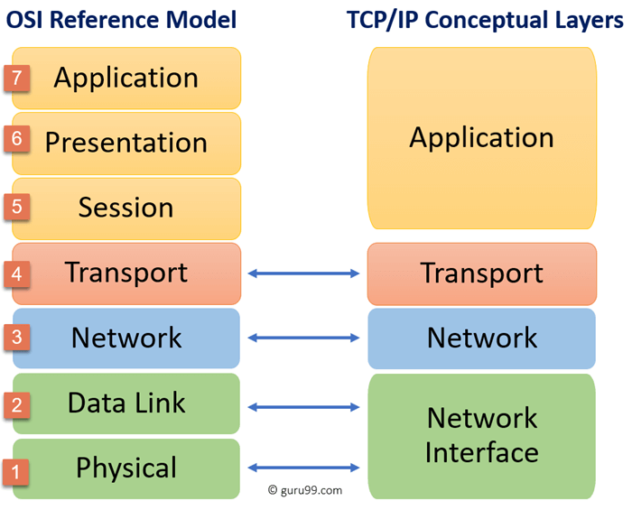
COMPARISON OF OSI AND TCP/IP MODEL

Slide 10
COMPARISON OF OSI AND TCP/IP MODEL
TCP/IP model is developed by Department of Defence, whereas OSI model was developed by ISO.
Four layers in TCP/IP whereas seven layers in OSI model.
________________________________________________________

Slide 11
Sample Questions
https://www.gkseries.com/data-communication-and-computer-networks/osi-model-and-tcp/multiple-choice-questions-and-answers-on-osi-model-and-tcp-ip-4
https://byjus.com/free-ias-prep/difference-between-tcp-ip-and-osi-model/
https://www.studocu.com/in/document/lovely-professional-university/internet-working-essentials/questions-on-osi-and-tcp-models/6968256

Slide 12
Thank you

